Slide 1
ICD-10 Code Validation using NLP Techniques on MIMIC-IV and CMS Datasets
A Graduate Project on Biomedical Natural Language Processing
Ajith Kumar Kannan
Rutgers University
BINF 5312 - Health Information Processing
04/22/2025

Slide 2
Introduction
The ICD-10 coding system is vital for patient care, billing, and research.
Errors in code assignments can impact reimbursement and quality reporting.
NLP techniques can support automated validation and reduce human error.

Slide 3
Project Objectives
To apply and evaluate NLP techniques to validate ICD-10 diagnosis and procedure code relationships.
Use real-world datasets: MIMIC-IV (clinical codes) and CMS ICD code descriptions.
Evaluate semantic and structural consistency using at least 4 different NLP methods.

Slide 4
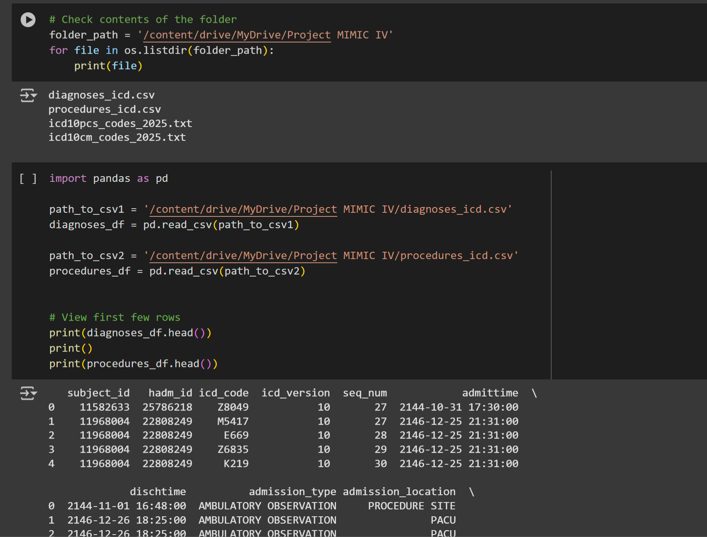
Datasets Used
MIMIC-IV v3.1: 3.4 million diagnosis codes and 390k procedure codes
CMS ICD-10-CM & PCS (2025): ~70,000 diagnosis codes and ~75,000 procedure codes with descriptions

Slide 5
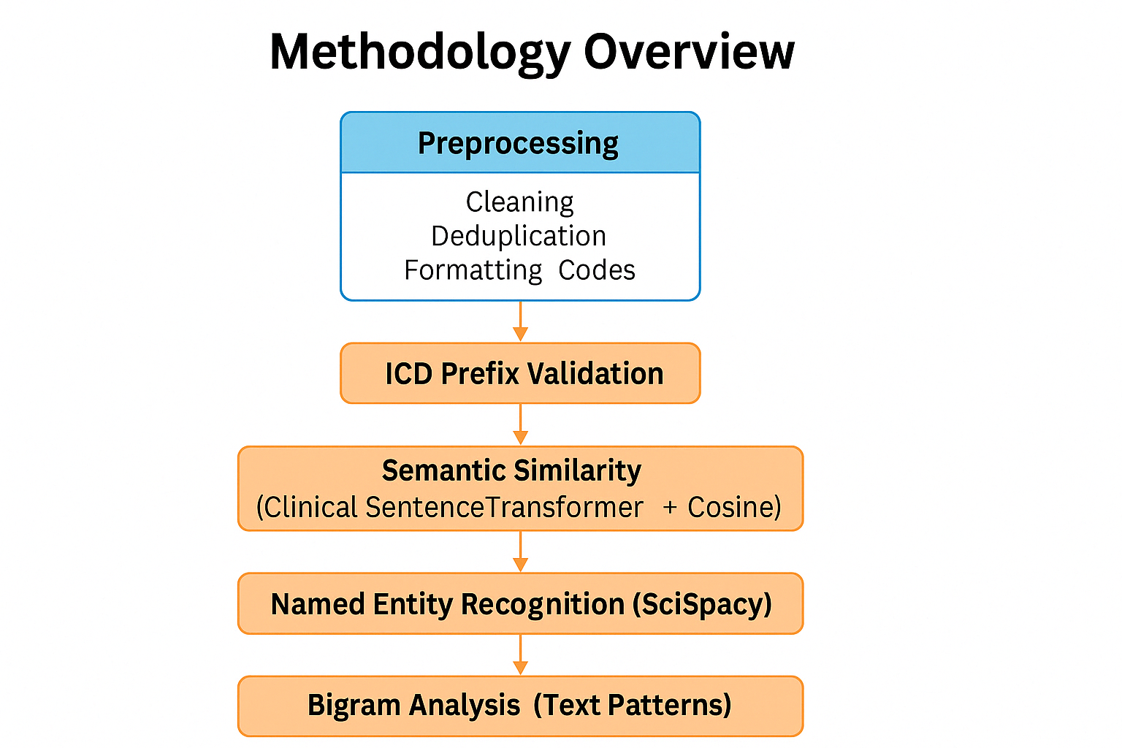

Slide 6
Technique 1 - ICD-10 Prefix Matching (Information Extraction)
Objective: Match diagnosis and procedure codes based on domain-specific mappings.
Approach:
Cleaned ICD-10 codes (removed dot for standardization).
Merged filtered diagnosis & procedure datasets on subject_id and hadm_id.
Used rule-based logic to validate clinically relevant code pairs.
Output: ✅ 105 valid diagnosis–procedure mappings.
NLP Aspect: Leveraged structured information extraction using medical code patterns and mapping logic.

Slide 7
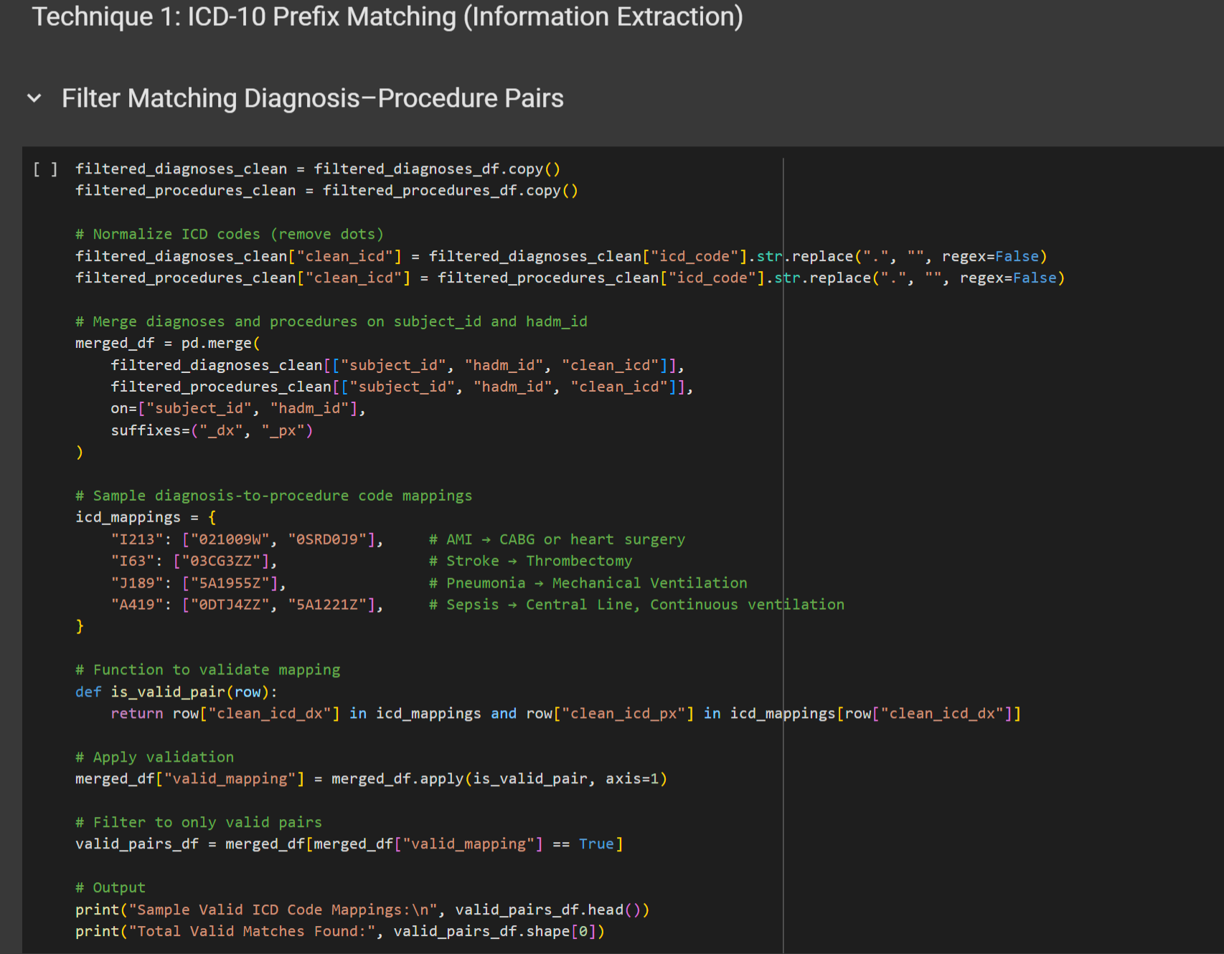
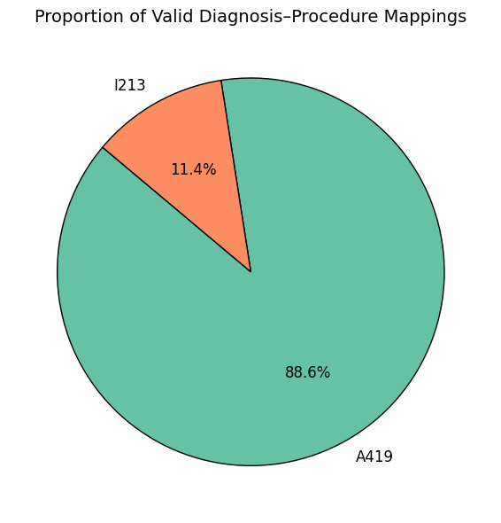
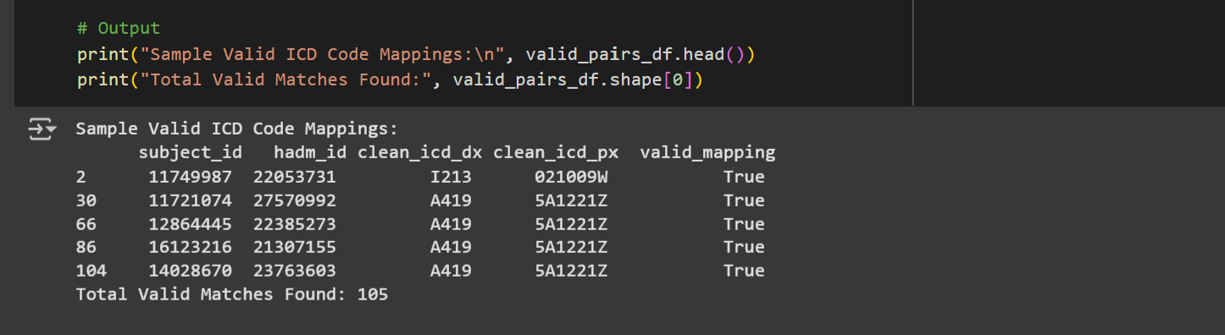
Technique 1: Code + Output

Slide 8
Technique 2 - Semantic Similarity with Clinical Sentence Embeddings
NLP Technique: Sentence Embedding + Cosine Similarity.
Model Used: Shobhank-iiitdwd/Clinical_sentence_transformers_mpnet_base_v2 (Hugging Face)
Method:
Encoded diagnosis & procedure descriptions into dense vector embeddings.
Calculated cosine similarity to identify the most semantically related procedure for each diagnosis.
Highlights:
Compared scores to Google Word2Vec baseline.
Clinical Sentence Embeddings gave superior similarity scores (e.g., I213 score = 0.9030).

Slide 9
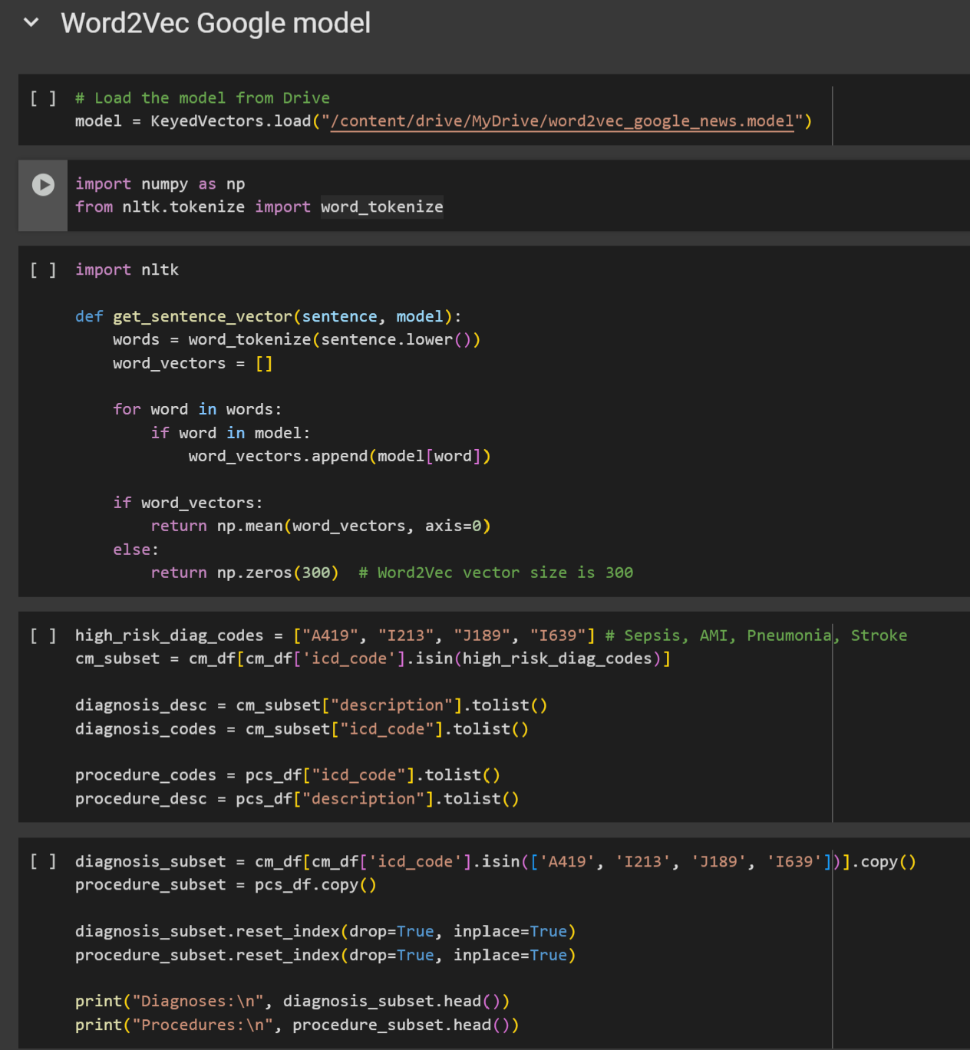
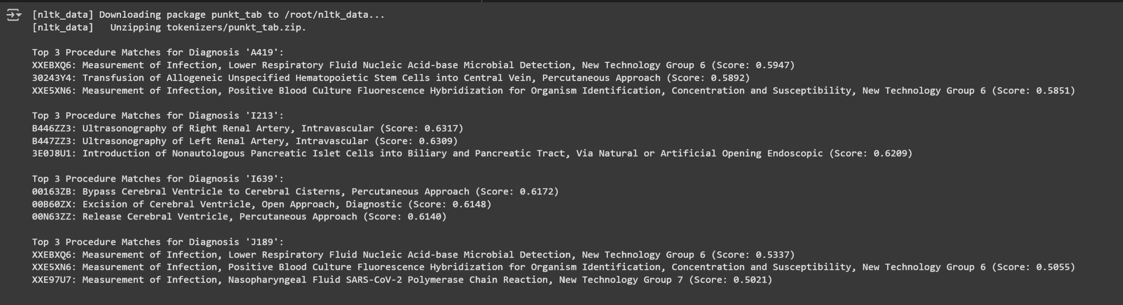
Technique 2 Code & Output

Slide 10
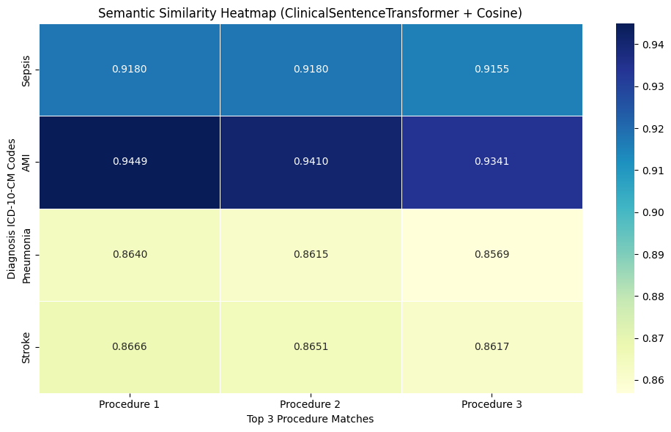
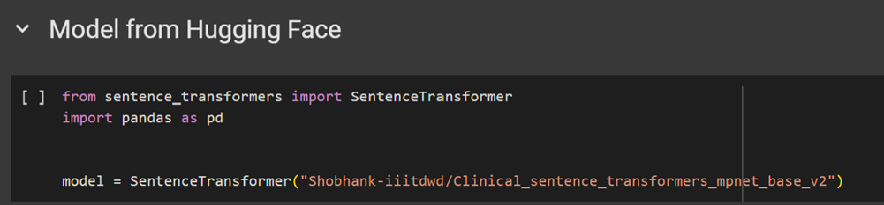
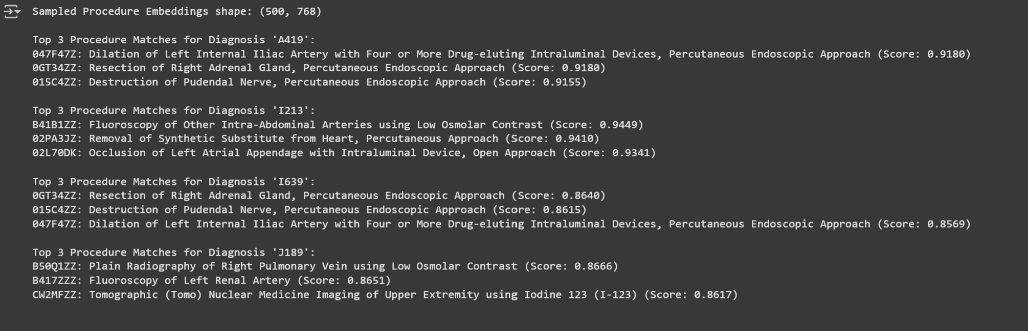
Technique 2 Code & Output
Visualization: Heat Map

Slide 11
Technique 3 - Named Entity Recognition (NER)
Model: en_core_sci_md from SciSpaCy.
Dataset: ICD-10-CM descriptions (train-test split).
Process:
Extracted medical entities such as body parts, conditions, and modifiers.
Focused on clinical phrase breakdown, e.g., "open fracture type I,” “sepsis,” etc.
Output: Highlighted domain-specific named entities from real ICD descriptions.

Slide 12
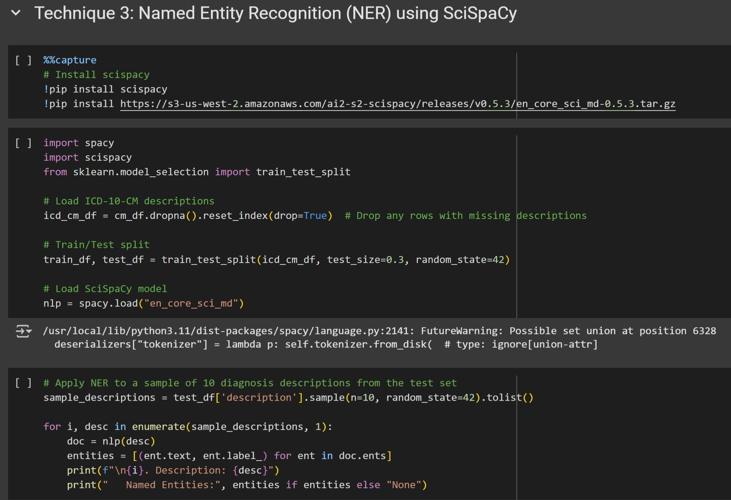
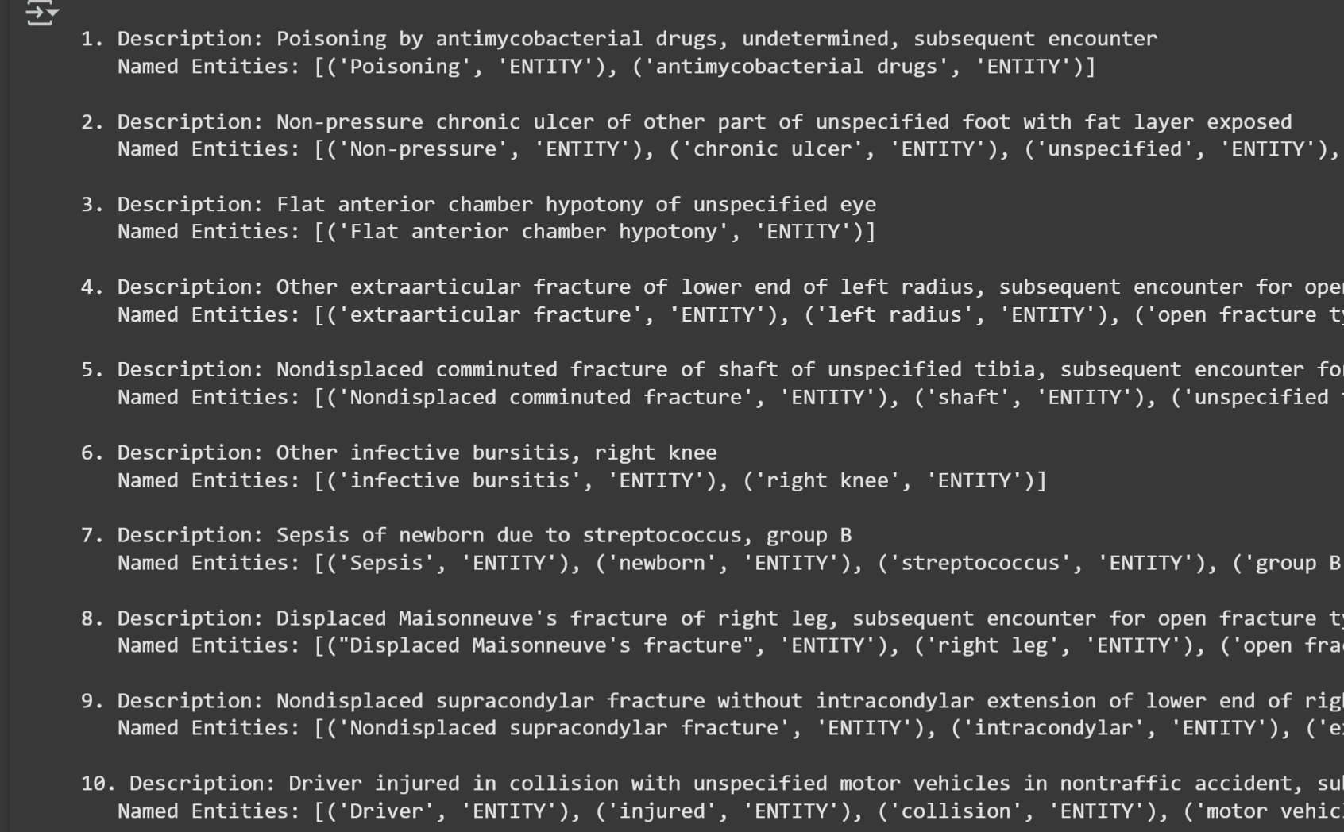
Technique 3 – Code & Output
NER helps deconstruct medical descriptions into interpretable clinical terms.

Slide 13
Technique 4 - Bigram Frequency Analysis
Tool: CountVectorizer with ngram_range=(2,2).
Process:
Extracted frequent word pairs from over 90,000 ICD-10-CM descriptions.
Highlighted repetitive clinical language patterns.
Common bigrams:
“subsequent encounter”, “open fracture”, “routine healing”

Slide 14
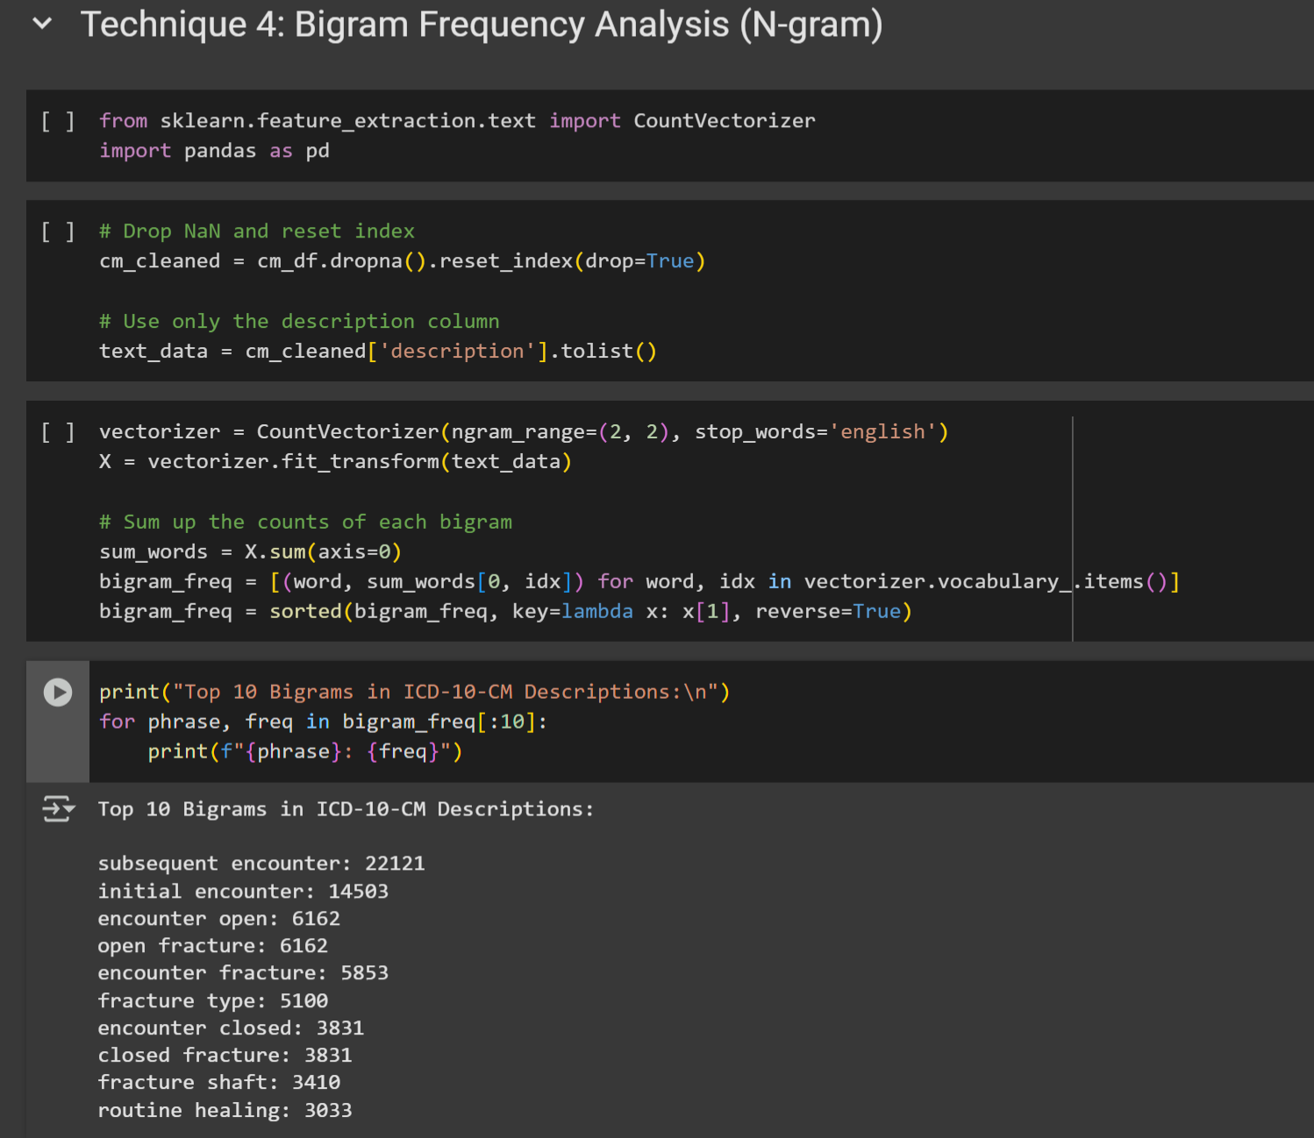
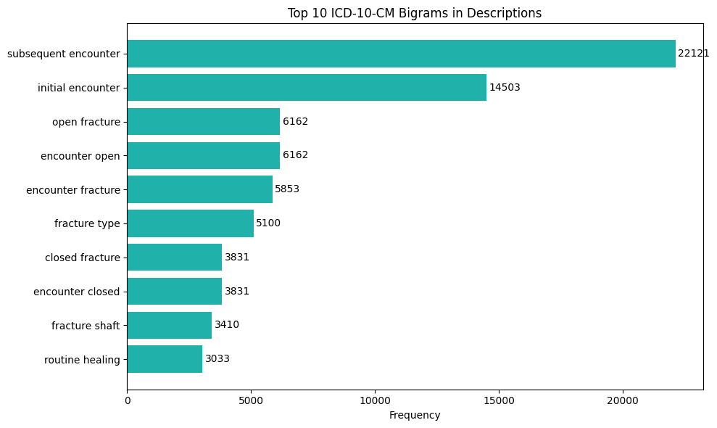
Technique 4 Code & Output
Visualization: Horizontal Bar Graph

Slide 15
Conclusion
Successfully implemented 4 NLP techniques using real-world clinical data.
Techniques like Semantic Similarity and NER improved the interpretability of ICD-10 codes.
Validated mappings help enhance medical coding accuracy and clinical decision-making.
Word2Vec & Transformer-based models revealed contextual relationships between diagnoses and procedures.
Project showcases how NLP can bridge unstructured medical data with actionable insights.

Slide 16

Created & Presented by
_____Ajith Kumar Kannan

